Slide 1
Multi-Class Classification

Slide 2
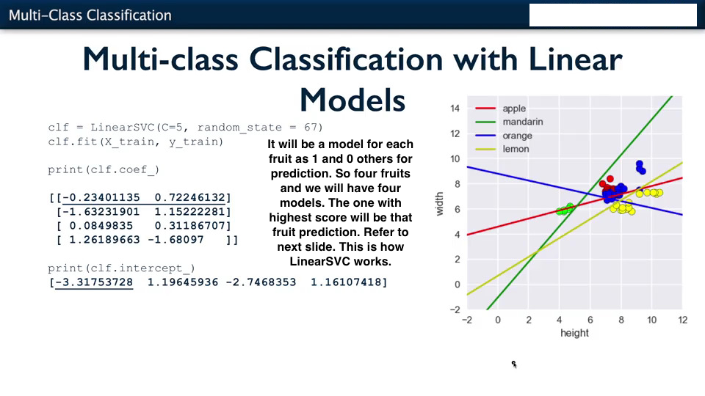

Slide 3
